Slide 1
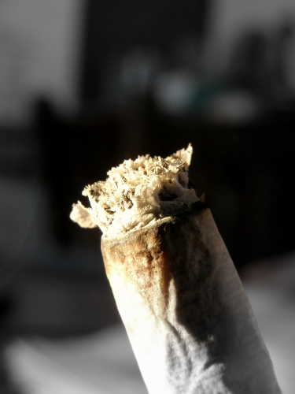
Southwest Hand Rolled
Tobacco (HRT)
qualitative research
DL 2401
March 2010
Directions research & marketing

Slide 2



Research commissioned by Helen Selby, COI, on behalf of Smokefree Southwest
The Printworks, 1 Blake Mews
Kew Gardens, Surrey TW9 3GA
T 0208 948 9000
F 0208 332 7370
E mail@directions.uk.com
www.directions.uk.com
Southwest HRT
Job No. DL2401
March 2010
Directions research & marketing

Slide 3
Contents
Research Context
Research Objectives
Research Approach Sample
Findings
Perceptions of HRT
Usage of HRT
Rituals of Rolling Up Benefits of HRT (vs. manufactured cigarettes) Reactions to Proposition Areas
Direction
Appendix (Proposition Areas & Messages tested) Appendix (Summary of Final Sample)

Slide 4
Research Context
Smokefree South West was launched in 2009. Its stated aims are to work with key partners at a local, regional and national level essentially to reduce the prevalence and uptake of smoking.
There are around one million people who smoke in the South West and smoking accounts for 9,000 premature deaths a year. Nationally, an estimated 1 in 4 smokers (35% of male smokers) smoke ‘mainly’ hand rolled cigarettes. The incidence of using hand rolled tobacco (HRT) has been increasing since 2003; it is believed that the primary reason for this is price, which has been heightened by the recession. HRT bought legitimately is cheaper than buying manufactured cigarettes, moreover research in other regions has identified that much HRT sold is illegitimate, which makes the product cheaper still.
Although HRT data in the South West was not available at the time of the research, there is no reason to believe that incidence will be lower than the national average, and a number of reasons to believe it may be higher: poor populations, rural populations, and a high percentage of younger smokers.
Smokefree South West wish to commission research to explore smokers’ experience of and beliefs about using HRT, in order to identify a strategy to undermine HRT use and prompt quit attempts.

Slide 5
Research Objectives
OVERALL BUSINESS OBJECTIVE
Identify a strategy to undermine HRT use and prompt quit attempts
PRIMARY RESEARCH OBJECTIVES
Explore perceptions of HRT in terms of language, imagery and associations (vs. manufactured cigarettes)
Explore usage of HRT in terms of reasons for usage, benefits/drawbacks, brands used, rituals and habits (vs. manufactured cigarettes)
SECONDARY RESEARCH OBJECTIVES
Evaluate and develop possible proposition areas
Identify any that have the potential to prompt HRT users to stop smoking (rather than revert to using manufactured cigarettes)

Slide 6
Research Approach
A staged approach was required to meet the objectives:
Understanding attitudes/behaviours Developing communications to encourage quitting
PRE-TASK
Personal in-depth account of views and behaviours in relation to HRT
CONSUMER WORKSHOPS/DEPTHS
Further exploration of perceptions and behaviour via discussion and debate, as well as enabling techniques
In-depth evaluation and development of propositions using creative techniques
Iterative process to build on learnings and develop proposition areas/messages fully
FOLLOW-UP
CALL BACKS
Checking resonance of propositions and potential for behaviour change
CLIENT ENGAGEMENT
Initial workshop to immerse team in R&M workers’ attitudes to smoking and develop messages
Interim feedback to keep client updated on outputs and develop proposition areas further

Slide 7
Sample
A different methodology was required for each audience type:
HRT USERS
- YOUNG PEOPLE
HRT USERS
- R&M ADULTS
MANUFACTURED
USERS – R&M
8 x 45 min Paired Depths
8 x 90 min Focus Groups
2 x 60 min Focus Groups
Pre-task
(4 groups only with
8 x videos)
14-15
Male
14-15
Female
16-17
Male
16-17
Female
20-30 years
Male
Pre Family
20-30 years
Female
Pre Family
20-30 years
Male
Pre Family
20-30 years
Female
Pre Family
25-45 years
Male
15-16
Male
15-16
Female
17-18
Male
17-18
Female
25-45 years
Female
30-45 years
Male
Family
30-45 years
Female
Family
30-45 years
Male
Family
30-45 years
Female
Family
Follow –up Call Backs
(16 respondents only – 2 from each group)
Research conducted during March 2010, in 6 Southwest PCTs (Bournemouth, Bridport, Bristol, Camborne/Redruth, Plymouth, Salisbury)

Slide 8
Sample Considerations:
Smoking Behaviour: all recruited on the basis of being HRT or manufactured cigarette users exclusively or mainly – all smoking at least 5 cigarettes per day
Routine & Manual status: all respondents were R&M workers, a range of different occupations recruited across the sample (including C1 as well as C2D social grades)
Age/Lifestage: to create homogeneous sessions the sample was split into younger and older sessions for adults, and year groups in case of teens
Gender: we convened single sex sessions as men and women have different attitudes/behaviours in relation to smoking and quitting – sample was split equally between men and women
Intention to quit: those with no intention to quit in the foreseeable future were screened out

Slide 9
Presentation Structure
Perceptions of HRT
Usage of HRT
Rituals of Rolling Up Benefits of HRT (vs. manufactured cigarettes) Reactions to Proposition Areas
Direction

Slide 10
Perceptions of HRT

Slide 11

There are a variety of different words used to describe HRT and manufactured cigarettes
HRT
HRT CIGARETTES
MANUFACTURED
Baccy
Rollies
Tabs
Backie
Straights
Roll-ups
Backie (teens)
Fags
Ollies
Tabs
Bakki
(teens)
Tailor-mades
Tobacco
Fags
Tailors
Snout

Slide 12

HRT is strongly associated with relaxation and stress relief
Names for Cigarette
Roll-ups
Rollies, Rollys
(Tabs, Cream Puffs, Ollys, Snouts)
Act of Rolling (adult)
Skill
Therapeutic
Stress relief
Required Ingredients
Pouch of tobacco (leaves)
Skins/Rizlas
Filters/’tips’
Roach (even cannabis)
Mood
Relaxing – smooth smoke
Chilled – associations with cannabis
Sociable, drinking
FUNCTIONAL ASSOCIATIONS
EMOTIONAL ASSOCIATIONS
Tobacco Texture
Fresh
Sticky, wet
(Messy)
Health risks (teens only)
Throat cancer
Health warnings on pouches
(taught in school)
» stronger sense of relaxation and stress relief vs.
manufactured cigarettes »

Slide 13
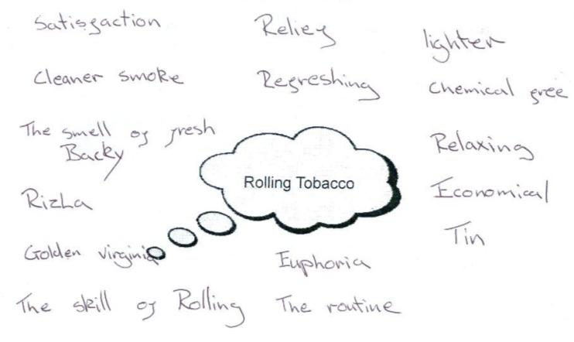
Some pre-task excerpts to illustrate....

Slide 14
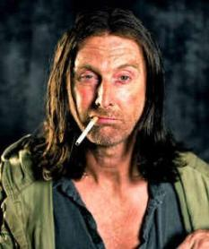

Typical HRT smoker is perceived to be laid back and relaxed, in terms of personality
Personality
Chilled
Laid back
Considers themselves slightly ‘alternative’
I think smoking rollies is very ‘South West’... we’re a bit rebellious down here, a bit more laid back and chilled out
Appearance
Casual, relaxed
Teens in coastal areas associate with surfers
Frank Gallagher
(Shameless)
It’s much cooler - surfers always smoke rollies, you’d never see them smoking a straight
Work & Location
Working class – less money
Outdoors work, rural areas
Rhys Ifans
» rolling tobacco is strongly linked with rural Southwest
culture – life is more laid back and ‘chilled’ »

Slide 15

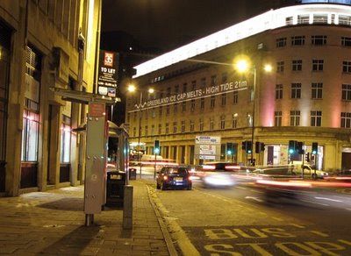
We have observed more widespread usage in rural areas, where tobacco smoking is the ‘norm’
RURAL
e.g. Camborne/Redruth
SURBURBAN/
URBAN e.g. Bristol
Everyone I know smokes rollies, you’re definitely in the minority down here if you’re smoking straights
More people smoking HRT generally, as lower disposable incomes
More likely to use HRT from an earlier age
Can feel like odd one out smoking manufactured cigarettes
More people smoking manufactured cigarettes – slightly higher disposable incomes
Some can feel embarrassed smoking HRT in public
Many have migrated to tobacco later in life
» less stigma/embarrassment smoking tobacco in rural
areas »

Slide 16

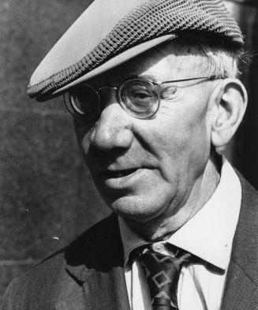
Historically, the typical HRT smoker has been perceived as an old man or a cannabis smoker
Young Cannabis Smoker
Student with less money
Chilled and relaxed
Likes having a joint with friends
Looked down on by society (to some degree) – not necessarily a negative for younger smokers
Old Man
Historically older working class men tend to smoke HRT (esp. Drum and Old Holborn)
Linked to mining/farming – R&M traditional jobs
Associated with older pubs
» for this reason, some older smokers can perceive HRT to
be less feminine »

Slide 17
However, the typical HRT user is evolving
Widespread usage nowadays - more women and young people are smoking roll-ups nowadays as it is cheaper alternative
  younger teens claim they can purchase pre-rolled cigarettes at school from friends (pre-rolled are cheaper 10-25p vs. 50p for manufactured)
Tobacconists are perceived to cater more for female users e.g.
  different flavours of tobacco, papers (e.g. Pina Colada), even filters (menthol)
  greater emphasis on ‘accessory’ elements of smoking HRT e.g. pretty cigarette cases, filters with beads in
Becoming more fashionable generally - smokers notice more and more young people using HRT
  teens strongly associate with cannabis usage (so cooler)
» less social stigma attached to smoking a roll-up
nowadays »

Slide 18
Female HRT smokers have different perceptions, based on initial reason for smoking rolling tobacco
ENTRY POINT
ATTITUDE TOWARDS HRT
EVERYONE (I KNOW) SMOKES HRT
Tobacco is a strong part of smoker’s identity, sense of being part of a club (social aspect)
Feel it is closely linked with their personality – laid back, relaxed etc.
No embarrassment smoking in public
IT’S CHEAPER
HRT is a means of affording to continue to smoke
Do not like to wear their tobacco usage as a badge of identity
Tend to be embarrassed about smoking HRT
» women more likely to smoke HRT if their partner or
another family member smokes tobacco »

Slide 19









HRT brands are initially divided based on strength/ taste, but then other factors come into play
STRONGER
HARSH
MILDER
NATURAL
MANUFACTURED
CONTEMPORARY
TRADITIONAL
FEMININE
MASCULINE

Slide 20



Brands more likely to smoke.....
Golden Virginia (or GV)
Mild/smooth/mellow taste , (doesn’t dry out quickly)
Natural associations cued by green pack colour and leaf imagery
Contemporary feel as most popular tobacco brand and also produce metallic limited edition packs
More feminine than masculine cues due to pack design (colour, imagery etc.)
Amber Leaf
Mild, smooth taste (cheaper alternative to GV, often comes with free papers, dries out quickly
Strong natural cues from pack colour, brand name and leaf imagery
Pack design is not as contemporary as others but retains appeal to men and women
Cutter’s Choice – more well recognised in Plymouth
Lighter taste
Strong natural cues from pack colour and fact that tobacco is wetter
Pack design is not as contemporary as others but retains appeal to men and women
Benson & Hedges Silver – smoked by a minority
Milder taste, although not as smooth as GV
Manufactured associations due to brand and pack colours/design
Contemporary and feminine feel due to silver metallic colour – teens and some women consider it a ‘cooler’ looking tobacco

Slide 21



Brands less likely to smoke.....
Old Holborn
Strong harsh smell and taste (‘for people with no taste buds’), some complain it makes throat burn, higher tar content
Not as natural looking as GV, Amber Leaf and Cutter’s Choice due to pack colour
Traditional and masculine – pack colour is very male, and brand has old man (pipe smoker) associations
Drum
Strong, horrible taste, ‘stinks’, cheaper and low quality
Has traditional and masculine cues for same reason as Old Holborn
Samson
Less well known but similar associations to Old Holborn and Drum

Slide 22
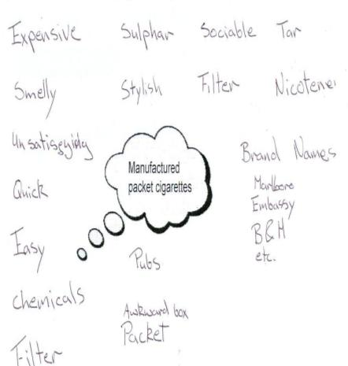
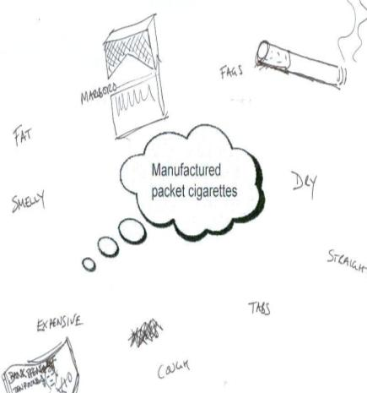
Manufactured cigarette associations are very different, as pre-task excerpt illustrates....
» referred to as ‘straights’ (no associations with drugs)
even ‘tailors’/’tailormades’ »

Slide 23
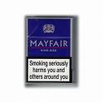



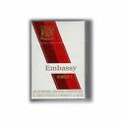


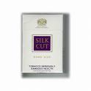

Manufactured cigarettes are grouped based on price; brand is less important nowadays
CHEAPER EXPENSIVE
STRONGER
Mayfair & Richmond associated with older women – often a harsher smoke
L&B considered a better smoke – some have migrated to this brand due to cost
Royals – good VFM (initially) as 25 in pack
May have started on these if younger (as cheaper) – indeed some teens only recognise cheaper brands nowadays
Overall feel that more people are smoking cheaper cigarettes nowadays – ‘you don’t see people with B&H and Embassy anymore’
B&H and Embassy seen as an identity badge when growing up for older smokers
Marlboro Red – very strong, man’s fag
POSHER CIGARETTES (older smokers)
Silk cut – very weak, ‘like smoking air’
Marlboro Lights associated with women and ‘yuppies’- very popular cigarette
MILDER
» majority smoking occasionally on night outs as more
convenient and socially acceptable (for some women) »

Slide 24

Can struggle to define the typical cigarette smoker, but often seen as more affluent and professional
Personality
Busy lifestyle
Always on the go
Posh
Work & Location
City/London dweller
Office worker
Well paid
(Appearance)
Concerned about looks
Wears a suit to work
» smoking snobbery still exists esp. in urban areas, women
admit smoking ‘straights’ for nights out »

Slide 25
Usage of HRT

Slide 26
HRT smokers tend to be smoking less tobacco vs. those smoking manufactured cigarettes
Diary entries show smoking less often (vs. manufactured cigarette studies) – same occasions but less often
  time takes them to roll up prevents them from reaching for a cigarette as regularly, except in rare cases of smokers who pre-roll large amounts
Smoking thinner cigarettes (vs. manufactured cigarettes)
  most prefer a thinner roll-up – can feel that there is too much tobacco in manufactured cigarettes
  women in particular favour super slim filters
Smoking less in public/out of doors
  due to the inconvenience of rolling up
My rollies are about a third of the size of a normal cigarette so I definitely smoke less
» smoking messages don’t always cut through as perceive
themselves to be moderate smokers »

Slide 27
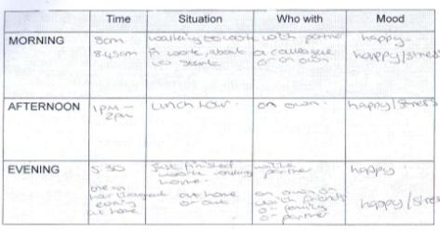
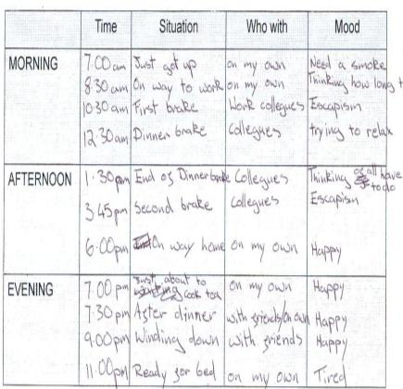
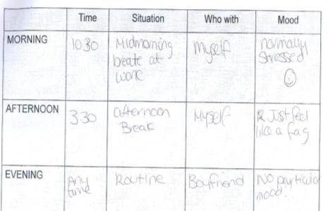
Some pre-task excerpts to illustrate.....

Slide 28
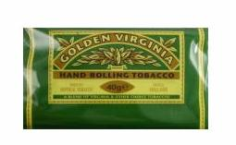


Majority purchase 50g packs due to VFM and convenience benefits
LARGER PACK (50g)
More VFM (can last 1-3 weeks depending on amount smoked)
Convenient as don’t need to purchase as frequently
More able to purchase illicitly (only tend to sell 50g packs)
BUT dries out more quickly
SMALLER PACKS (25g/12.5g)
Doesn’t dry out as quickly (as larger pack)
Good size if wanting to cut down
Teens more likely to smoke 12.5g as cheaper (more accessible) if not buying illicitly – teens can be sourcing through their parents
» most purchasing illicit tobacco regularly - less concerns
about counterfeit tobacco vs. cigarettes »

Slide 29
Most purchase illicit tobacco on a regular basis
Mainly buying from friends and family
All claim that when they go on holiday they buy tobacco in bulk and then sell to friends/family
Represents a much cheaper alternative and makes smoking an even more affordable habit
  on average costs £6/6.50 vs. £12 in shops for 50g pack of Golden Virginia
Less concerns regarding counterfeit tobacco
  don’t find that counterfeit is as prevalent in tobacco vs. manufactured cigarettes

Slide 30
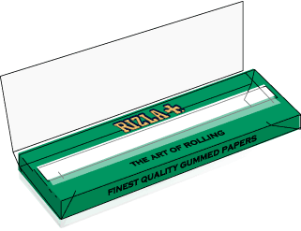
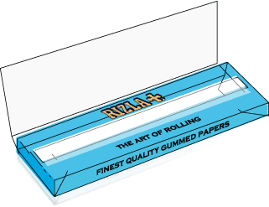
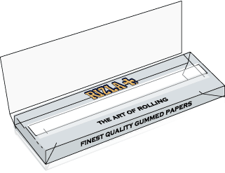
Most smokers using Rizla Blue or Green papers; Rizlas are considered a more natural alternative
GREEN
Good thickness – not too thin or thick
Cut corners mean able to tell what is the right way up (especially good if rolling in darkly lit areas)
More likely to use if less proficient/skilled
BLUE
Thinner and lighter
More likely to use if smoking cannabis or if have migrated from cannabis usage
Less paper means a smoother smoke and ‘healthier’
SILVER
Very thin
Difficult to roll – considered a real art
Can be considered a little bit ‘tar-y’
Most strongly associated with cannabis usage
THINNER
» different flavours are not popular and considered more
of a novelty – Swan and OCB papers also available »

Slide 31
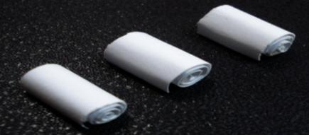
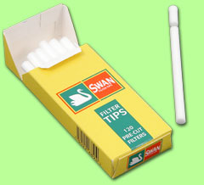
Majority use filters, esp. popular with female smokers
MORE MASCULINE MORE FEMININE
ROACH OR NOTHING
FILTERS
Roach more likely to be used by men, has following associations:
  Stronger smoke
  Easier to drag
  More manly
  Cannabis usage
BUT if making roaches need to use a lot of cardboard, adds a further element to the ritual of rolling up, can get soggy
More feminine associations – women often prefer slim filters
Means roll-ups more closely resemble cigarettes – important for women who have often migrated
Avoids getting tobacco in mouth
Can be seen as healthier by some – catches toxins, less of a strong smoke
Swan are the most popular brand and very cheap (e.g. 120 for 65p)
» Clipper lighter works well to push filter/roach into place »

Slide 32
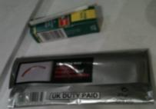
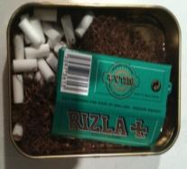
Most often all elements are kept in tobacco pouch
ALL IN POUCH
Most popular option for men – seal is important to keep tobacco wet
Papers (and filters) are kept in the tobacco pouch
Easy to stick in back pocket – more flexible
BUT papers can become a little messy
FILTERS AND PAPERS SEPARATE
Filters and papers are kept together in small box – Swan Combi box works well – but not put in the tobacco pouch
Tobacco doesn’t get mixed in with filters and papers (annoying for women)
ALL IN TIN
Women often using tins for pre-rolled when going out (can appear more elegant) whereas men keep all individual ingredients inside
Tins can be difficult to source – can have rude slogans and drug references on them which is embarrassing
A minority of women have bought feminine, pretty tins (living in areas where high prevalence of HRT usage)
» some claim to have reserves of additional elements
as they worry about running out »

Slide 33
Benefits of HRT vs. Manufactured Cigarettes

Slide 34
Cost is cited as the initial, main advantage of smoking rolling tobacco
Significantly cheaper vs. manufactured cigarettes
  particularly as many buy HRT illicitly e.g. £6/6.50 for a 50g pack of Golden Virginia vs. £12 in shops
Delivers to a real need in current economic climate
It is also more cost effective for the following reasons:
  many smoking less cigarettes as need to roll
  able to adjust size of cigarette so if running low you can ration the amount of tobacco you use
  roll-ups burn out when not smoked so not wasting tobacco
  less likely to be asked for a fag if smoking roll-ups by straights users/social smokers so your tobacco really is just your tobacco
  tobacco is more resilient vs. cigarettes (when carrying in pocket) – doesn’t get crushed
» however, cost is not the singular and most important
benefit – only minority would switch to manufactured »

Slide 35
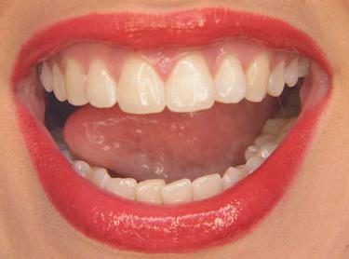



4 additional benefits are cited; taste is the key benefit
TASTE
NATURAL
CONTROL
SMELL
PRACTICAL BENEFITS
EMOTIONAL BENEFITS
» on reflection, the ritual of rolling is also an emotional
benefit for some »

Slide 36
It’s purer than cigarettes – cigarettes have got sulphur and twigs and stuff in – roll-ups just burn out unlike cigarettes
It’s a cleaner and smoother smoke than cigarettes - cigarettes are stronger and give you a bigger hit
TASTE
NATURAL
CONTROL
SMELL
There’s no chemicals in it– you don’t get a bad chest smoking tobacco
It’s not as harsh smoking baccy, your throat doesn’t hurt afterwards
My partner is not so worried that I smoke baccy as it doesn’t smell like cigarettes
I like the fact that I’m in control of the amount of tobacco I smoke.... In the morning I roll an extra big one because that’s when I need to wake up, but sometimes if I’m not feeling well and I have sore throat, I’ll roll a smaller one
They smell sweeter and the smoke doesn’t linger in the same way – fresh baccy smells nicer
You also get less ash when smoking rollies
» natural and control benefits mean HRT smokers feel less
guilt – ‘It’s more natural and I’m smoking less tobacco’ »

Slide 37
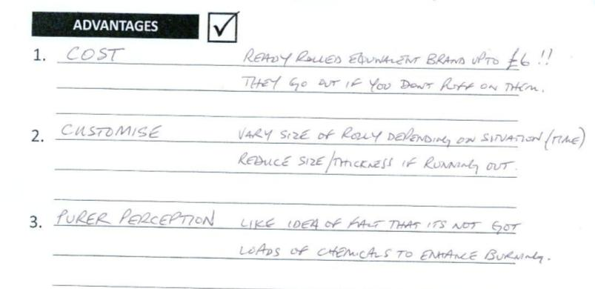
Some pre-task excerpts to illustrate....

Slide 38
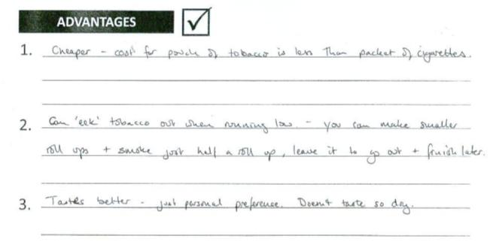
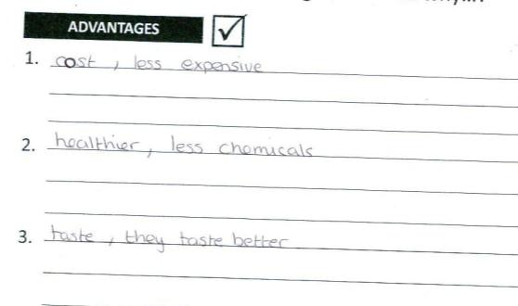

Slide 39
In addition, some feel HRT is a better accompaniment to cannabis
It’s much better to roll spliffs using baccy... You’re wasting your money if you use straights as you only use a bit and then throw the rest away
More moist and mixes better with ‘weed’
  tobacco from manufactured cigarettes is too dry and difficult to roll
Both rolling tobacco and cannabis are considered to be ‘natural’ products
  produce a nicer, smoother tasting joint
  and some harder elements in manufactured cigarettes can pierce paper e.g. smaller twigs
Better VFM as don’t end up throwing tobacco away
  don’t use all tobacco in a manufactured cigarette when making a joint
N.B. approximately third of the sample admitted using cannabis currently or in the past
» others feel tobacco from manufactured cigarettes
is better as burns more quickly »

Slide 40
Smokers can struggle to suggest downsides of smoking HRT
On consideration, the key drawback is INCONVENIENCE
  rolling up in certain situations (e.g. on a night out, in adverse weather, when driving, on smoking break at work, when drunk)
  messy, especially if hands are too dry/wet
  pre-rolling (in the case of women)
  roll-up getting stuck on your lips, tobacco on teeth
  filter/roach falling out on occasion
  roll-up keeps going out
  having to (remember to) carry lots of different items with you
  different elements run out at different times
And for some there is still a social stigma attached to smoking roll-ups
  manufactured cigarettes are considered more ‘stylish’ (amongst many older smokers)
For that reason almost all adult smokers buy and smoke manufactured cigarettes on occasion (i.e. when out and about, when driving)
  some smokers (tend to be older women) also feel less self conscious smoking a manufactured cigarette in public

Slide 41
To illustrate....
“
Cigs are easier on a night out – there’s nothing worse than dropping your Rizlas in your beer
I work in a kitchen and if you have a fag break you need to dry your hands really well, or they get the papers wet
If your mates are smoking straights and they say ‘Are you coming out for a fag?’ you’re always a few minutes behind them because you’ve got to roll one up.. that’s a bit annoying really
I hate it when you canoe it – when it burns down the join side...you look proper stupid and then you have to roll again
It is a right pain rolling up outside...especially after a few beers too! I’ll just nick a straight off a friend instead

Slide 42
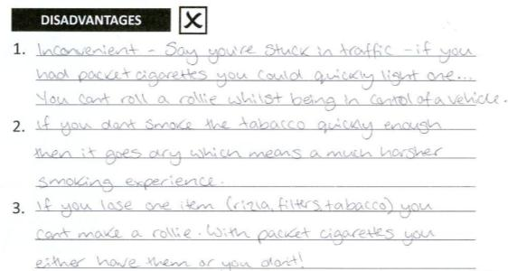
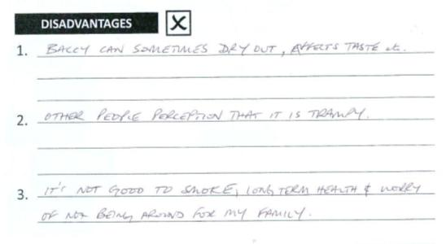
Some pre-task excerpts to illustrate....

Slide 43
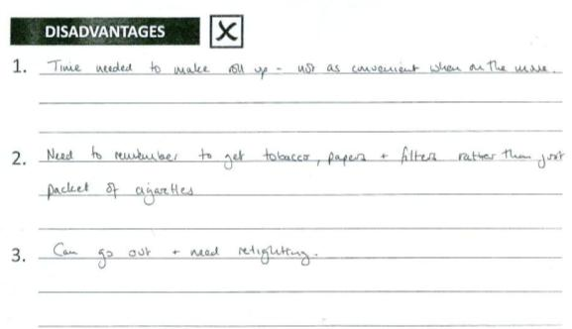
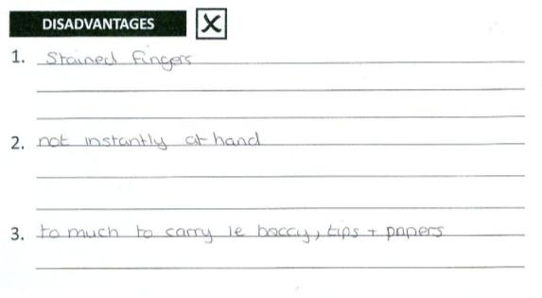

Slide 44
Rituals of Rolling Up

Slide 45
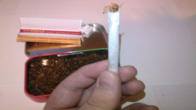
Rolling up is considered a real skill;
Rizla’s slogan is ‘the art of rolling’
Rolling tobacco smokers admit that it takes a long time to learn to roll-up and create the perfect ‘rollie’
  i.e. even width, no creases in paper, no tobacco hanging out the end, ‘pulls’ well, no canoeing/side burns down, as quickly as possible
  some women still use machines as find it difficult to roll up
For teens a rite of passage/entry to adulthood
Therefore, there exists a real sense of pride/achievement when the roll-up looks good (and this never goes away!)
  likely to take greater pride if migrated from/still smoke cannabis as then your skill is on show when passing joint to others
All claim that a well rolled roll-up is more satisfying to smoke
» many feel they smoke less cigarettes due to ritual of
rolling up, but enjoy more satisfying cigarettes »

Slide 46
However, there exist a minority of smokers who don’t enjoy rolling up
Heavier and older smokers can find rolling up an irritation
  will ask their wives/work colleagues/(grand)children to roll cigarettes for them
Some women admit that they find it difficult to roll-up
  for this reason they use a machine, which can be inconvenient at times
In addition, it is also less enjoyable rolling up when there is no obvious surface available
  smokers look for opportunities to roll up when out and sitting down e.g. travelling on public transport, when sat down in McDonalds

Slide 47
Rolling up in 4 easy steps......
Step 1
READY....
Loosen/fluff up tobacco in pouch, take Rizla paper gum side up, (put filter behind ear or in mouth)
Step 2
STEADY....
Place open Rizla on open side of pouch/tin lid, (place filter/roach at end), spread tobacco across fold (ensure even width)
Step 3
ROLL (longest time spent at this step)
Grab both ends with thumbs together in middle and roll several times, tuck down paper (and run nail across)
  LICK, STICK & FINISH
  Lick, stick, discard any excess tobacco from ends and make cigarette neat, (pinch and twist one end), (place roach in other end)
Step 4

Slide 48
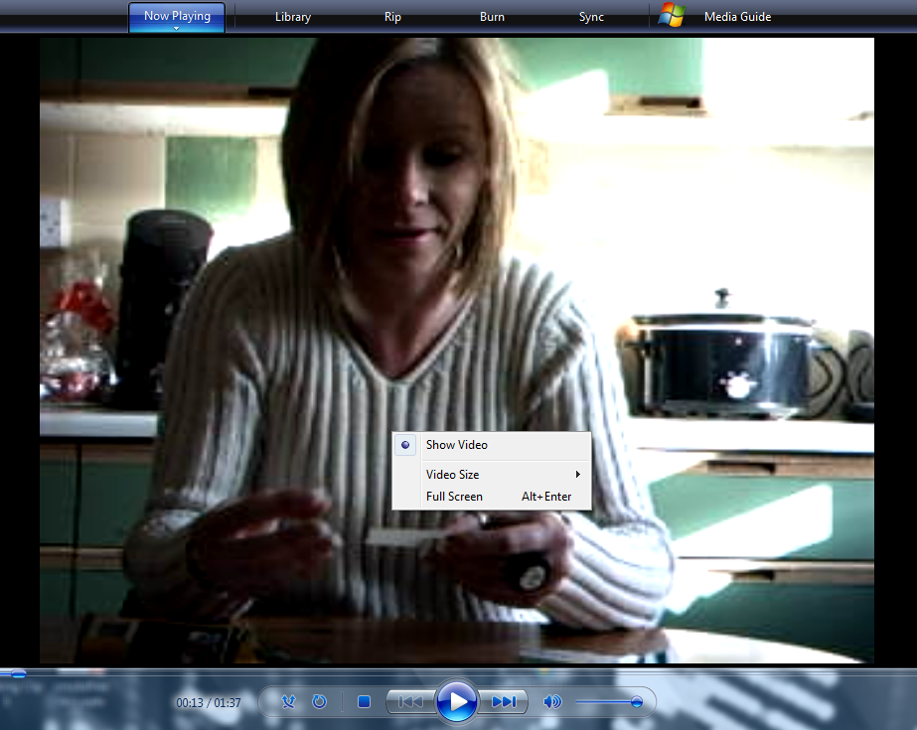
Video clips to illustrate….
» as we can see rolling up is a very quick process for
most »

Slide 49
The act of rolling up also has emotional benefits for some, especially for women
Considered to be very de-stressing and therapeutic for women when rolling up at home
Provides smokers with me-time/chill out time
  particularly relevant for female smokers with children
  indeed minority of women claim to pre-roll 120 cigarettes on an evening
Helps to combat boredom in the case of some men and teenagers – has become an addiction in itself
  can be concerned about how to occupy hands if they quit
What would I do with my time - I’d be well bored
I avoid rolling up when the kids are there – I don’t like them to see it and it gives me time to myself
» NRT will need to replace the addiction of rolling up as
well as smoking per se »

Slide 50
However, some women can be embarrassed rolling up in public
  During the groups some women are observed rolling up on their laps rather than on the table
    particularly those who have migrated from manufactured cigarettes
  Some are embarrassed about their lack of proficiency, especially if use a machine
  They all lick the paper as quickly as possible
    some claim that they feel most embarrassment licking the paper due to sexual connotations
  For this reason women can prefer to smoke pre-rolled or manufactured cigarettes in public

Slide 51
Reactions to Proposition Areas

Slide 52
Many respondents claim they have tried to quit smoking previously; key reasons are:
HEALTH OF CHILD
Many women give up smoking when pregnant as concerned about effects on child
Male partners also try to quit with birth of a new child as don’t want to expose child to smoke
OWN HEALTH
Illness or death of a family member/ friend due to smoking has impact
Some (especially men and those who are more sporty) have quit in past due to health concerns (often manifested by shortness of breath)
APPEARANCE TO OTHERS
Can be persuaded to quit by partner, if partner is a non/ex-smoker
Worried that they will appear unattractive e.g. smell/taste bad (a bigger preoccupation for women)
MONEY
A minority have quit in order to save money – tends to work best if there is a tangible item that they need
» teens tend to consider smoking a phase, and believe
they will quit in future – more conscious of health issues »

Slide 53
The following quitting proposition territories were explored in HRT user groups (all messages included in appendix)
1. DANGEROUS SUBSTANCES
CHEAP AS AN
EXCUSE
REPOSITION THE
RITUAL
BRAND SWITCH
TO NRT
5. IMPACT ON APPEARANCE
DE-NORMALISING
» Dangerous Substances is the most successful territory »

Slide 54
Affirming the dangerous status of HRT likely to make HRT smokers contemplate quitting
Dangerous Substances – Overall Reactions
Debunking myths around the ‘natural’ status of HRT captures attention and very specific to HRT usage – ensures HRT smokers are not ‘off the hook’
  all believe that rolling tobacco is a natural and healthier alternative to manufactured cigarettes, therefore facts around content and growing methods have real impact and start to make smokers think
  this is an area where hard facts/statistics will need to be presented to ensure credibility (as natural associations are so ingrained)
However, linking smoking to cancer and heart disease is considered ‘old news’ and generic
  all are aware of the risks of smoking, therefore can feel like a very obvious message territory
  in addition, many smokers continue to be sceptical about the risks of contracting cancer via smoking
  is there potential to take a more disruptive approach e.g. idea of self harm (especially interesting for teens)
» this territory has most impact as it is ‘new news’ and
HRT specific »

Slide 55
The most motivating messages are as follows:
Dangerous Substances – Key Messages
HRT smokers have ‘organic’ perceptions of manufacturers (HRT comes from the field and is not processed by big tobacco companies) so this makes smokers start to question their assumptions
B&H entering market may start to help dispel these myths to some degree
Word ‘harmful’ works better than ‘dangerous’ as is more health oriented and less inflammatory
‘Your tobacco is just as harmful – grown in the same place, processed by the same company’
HRT smokers are often unaware that rolling tobacco contains such toxic ingredients
Arsenic, formaldehyde, cyanide and carbon monoxide are key ingredients which most concern smokers –considered to be poisonous substances whereas others are perceived to be distasteful only
Filters can be seen as a means of limiting harmful contact so need to ensure this is considered
‘The smoke you inhale from HRT contains.....’
‘Scientific research has found significant levels of toxic chemicals even in pure additive free tobacco’
Some are aware and minority have even used American Spirit and remember ‘no additive’ claims, therefore this works to dispel myths
Words ‘scientific research’ help to increase credibility although ‘toxic’ is a little strange

Slide 56
It is important that messaging dispels myths and convinces HRT smokers of the true danger
Dangerous Substances – Next Steps
It is important to acknowledge that manufactured cigarettes and HRT are different but equally dangerous (even when smoking less tobacco!)
  listing the contents of manufactured vs. HRT cigarettes may assist
  this may also help to explain why roll-ups go out, and will help to prevent smokers using this as evidence that HRT contains more natural ingredients
There is a need to dispel the positive, organic and traditional imagery around HRT growing/production processes
  show HRT smokers that rolling tobacco is actually produced on a grand scale e.g. in a huge tobacco company plant (visual evidence may be required)
  this may also help to distance HRT from Southwest rural culture
  Firm facts are required to increase credibility and prevent scepticism – this approach is also less challenging as merely presenting information
  Questioning approach also works well to increase consideration of the issue amongst smokers, and invite scepticism

Slide 57
Cost alone is not motivating, unless used in conjunction with another territory
Cheap as an Excuse – Overall Reactions
Overall reactions to this area are polarised based on amount of tobacco smoked and income level of smoker
  those that smoke heavily and have lower incomes are initially motivated by savings – a tangible benefit of quitting (esp. in current climate)
  teens are also more interested as have low disposable income
However, on reflection most don’t believe there are substantial savings to be made
  even those smoking heavily tend to be spending less than £40 per month (including papers and filters), and many are purchasing illicitly
  talking about savings on a household level may be more motivating or even being able to offer a cash incentive for quitting
  in addition, those who have migrated from manufactured cigarettes believe they have made a positive choice and are already saving
  NRT in comparison is felt to be an expensive option
Cost is only motivating when linked to another proposition area (e.g. health)
  in this instance including references to cost make the messaging HRT specific

Slide 58
The most motivating messages are as follows:
Cheap as an Excuse – Key Messages & Next Steps
‘A cheaper way to die’
Direct and concise message works well to gain attention and convince
Linking cost with health is disruptive and has impact – it turns the positive of opting for HRT (low cost) on its head
However, some smokers are still sceptical of the long term health implications of smoking – ‘my nan smoked all her life and lived till she was 90’, ‘you have to die of something’
Tonally this message appeals as is it very positive and non-judgemental, which is perceived to be different to previous smoking messages
Presenting a tangible benefit of quitting initially motivates, although the figure is considered incorrect
However, a minority can question ‘no work required’ as quitting is considered hard work
‘Earn an extra £100 a month, no work required, just quit the fags’
» this territory operates better as a support (additional
benefit of quitting) rather than as a lead message »

Slide 59
Concern that this area will lead HRT smokers to switch to manufactured rather than quit
Reposition the Ritual – Overall Reactions
All admit that rolling up can be inconvenient at times (especially for heavier smokers)
  in fact inconvenience is cited as the key disadvantage of using HRT
  However, smoking in general considered inconvenient since Smokefree legislation has come into force
However, rolling tobacco smokers do not necessarily feel that they are missing out when rolling up
  in most cases time taken to roll up is 2-5 secs
  some women (who are pre-rolling) take longer but consider it relaxing, even therapeutic

Slide 60
The most motivating messages are as follows:
Reposition the Ritual – Key Messages
This is a real concern for parents, although does feel like ‘old news’ for many
However, does resonate more strongly for HRT users as more for child to copy (ritual of rolling as well as smoking per se) – admit that they roll up away from child
Can appear dictatorial on a tonal level
‘Another bad habit for your child to copy’
‘One of the most dangerous substances you will ever handle, 1 in 2 tobacco smokers dies as a result’
Statistic is motivating, smokers feel it really could happen to them when say ‘1 in 2’ – some use cite lottery statistic as an additional motivating fact
Words ‘danger’ and ‘handle’ feel odd in context of smoking
Message requires further qualification (e.g. die early)
Tonally more acceptable as just presents the facts, although some do want proof
‘Imagine never having to roll another one again, wouldn’t life be easier’
Not all agree that is hard to roll up, although admit that there are times when it would be easier, but odd occasions rather than a daily inconvenience
More motivating for heavy smokers who dislike rolling up
But not ‘easy’ to quit
» this territory operates better as a support rather than
as a lead message »

Slide 61
If linked to Dangerous Substances and/or Appearance areas, then potential to motivate
Reposition the Ritual – Next Steps
If link to Dangerous Substances....
  position the ritual of rolling up as similar to other addictions which are perceived to be ‘more serious’, ‘dirtier’ and less socially acceptable e.g. heroin usage
  Is there also scope to counter the perceived benefits of rolling up (e.g. relaxation, stress relief) by talking about what the actual toxins are doing to the smokers’ body?
  (N.B. HRT smokers only admit that they are addicted to smoking rather than rolling up too, but their attitudes and behaviours contradict this)
If link to Appearance....
  there is scope to talk more about the physical downsides of handling tobacco e.g. smelly hands, yellow fingers (toxins going into skin)
  is there also potential to visually depict dirtiness of habit?
Finally, it may be more powerful and motivating to focus on quitting as freedom from the addiction/ritual of rolling
  smoker’s day would no longer be ‘controlled’ by rolling up/smoking

Slide 62
Appearance is a motivating reason to quit for female smokers (although more generic)
Impact on Appearance – Overall Reactions
Women are concerned about ageing and the impact of smoking on their looks
  in terms of appearance more concerned about yellow fingers and teeth rather than wrinkles, pallid skin and bags under eyes
  however, smell (on breath, clothes etc.) is an even greater concern, although believe HRT is less smelly vs. manufactured cigarettes
Reducing attractiveness is more impactful for those who are single or have a non/ex-smoker as a partner
  some admit that when they have quit in the past they rejected their partner at points due to smell
In addition, roll-ups not considered elegant/feminine
  some are embarrassed smoking roll-ups in public, although some new entry brands (e.g. B&H Silver even American Spirit) perceived to be cooler amongst young people and women
Finally, some men (those who tend to engage in fitness and more physical jobs) also worry about how they look in front of male friends/colleagues when out of breath (due to smoking)

Slide 63
The most motivating messages are as follows:
Impact on Appearance – Key Messages
Very impactful to female smokers – this message mirrors their worry
Not all pick up on the fact that this is in comparison to manufactured cigarettes – comparative adjective can confuse some, therefore this message becomes generic rather than HRT specific
Tonally, this is fine as smokers accept this as a truthful statement
‘You might think it tastes better, but it doesn’t to your partner’
Only motivating to those who exhibit embarrassment smoking HRT (tends to be women who have migrated from manufactured cigarettes)
Could motivate more strongly if talk about tangible examples of handling tobacco e.g. stained fingers
‘Rolling up isn't pretty ’

Slide 64
Need to bring this territory to life and make more HRT specific
Impact on Appearance – Next Steps
Linking appearance with the ritual of rolling up will help to deliver more convincing messages e.g.
  embarrassment rolling up, especially when licking the paper
  coming into direct contact with tobacco – leaves tangible reminders (i.e. yellow, smelly fingers)
Need to talk more about smell (as this is the primary, top of mind concern for most)
  smell of actual cigarette may be less smelly (vs. manufactured cigarettes) but the smoker him/herself may actually be smellier due to handling tobacco

Slide 65
This territory receives polarised responses
Brand Switch to NRT – Overall Reactions
Not all believe that NRT is the right way to quit
  many R&M smokers believe that ‘cold turkey’ is the best approach – ‘you should give up nicotine completely not switch to something else’
  indeed there exists confusion and lack of understanding re. NRT
In addition, smokers also worry whether NRT is truly effective, particularly since it can be considered an expensive option!
Therefore need to provide evidence of effectiveness and more information generally to convince smokers
  greater interest in inhalators as gives you something to do with hands (important for HRT users as need to tackle addiction of rolling up as well as smoking)
  interestingly, a minority of parents say that teens are using inhalators in schools
However, those that have used NRT previously are quite positive
  believe it takes away/minimises the need for cigarettes, which is encouraging for those who want to quit and haven’t used
» desire for success stories and facts – more willing to try
if a friend/family member has tried and had success »

Slide 66
The most motivating messages are as follows:
Brand Switch to NRT – Key Messages & Next Steps
It is the dozens of other components that occur naturally in tobacco that make smokers sick. In fact, the nicotine in tobacco makes you feel good and that’s what you crave when you get the need to smoke. Most people are surprised when we tell them that nicotine is not dangerous at all to most people...so if you consume nicotine without tobacco it’s safe! So why not swap your tobacco for another safe type of nicotine? You can get it in gum, patches, drinks, inhalators etc.
This is interesting for most as it represents ‘new news’
Most have previously believed that nicotine is the harmful element so this makes NRT more appealing (often recalled during follow-up calls)
However, there is still concern about being ‘addicted’
Too long and descriptive in its current format
Direct tone and concise wording gains attention
Message itself can feel quite obvious,
‘Cancer’ reference can lead to strong reactions (as mentioned already)
Need to convince that NRT will halt cravings – ‘fix’ goes some way to do this
‘Get the nicotine fix without the cancer causing chemicals ’
» works best as a support to dangerous substances –
stronger resonance if able to speak to someone with experience of NRT»

Slide 67
There is concern that this territory will lead to rebellion amongst R&M smokers
Denormalising – Overall Reactions
All smokers are very conscious that they are in the minority in society – Smokefree legislation has certainly denormalised smoking
  interestingly, stating that the majority of people are non-smokers can make some smokers feel that smoking is less of a problem/issue in society which for some means there is less impetus to change behaviour
Concern that this territory can lead to rebellion as smokers will feel even more ostracised/excluded
  some begin to exhibit sense of martyrdom
  potential for messaging in this area to seem like finger wagging
However, this territory is also difficult to deliver in the Southwest
  HRT smokers are in the majority amongst smokers in the Southwest so difficult to talk about HRT specifically at a regional level

Slide 68
Direction >>

Slide 69
To prompt and help HRT smokers to consider quitting we recommend the following approach:
DANGEROUS SUBSTANCES
(recalled by all during follow-up call backs)
Supported by facts and scientific evidence to dispel natural myths, also need to reinforce that dangers exist no matter how much you smoke
LEAD
MESSAGE
REPOSITION THE RITUAL
IMPACT ON APPEARANCE
SUPPORTING
MESSAGES
Physical Intervention
SWITCH TO NRT
Inhalators are of particular interest to HRT users
Emotional Intervention
SUPPORT
e.g. encouragement via friends all quitting together, even cash incentive
INTERVENTIONS

Slide 70
Currently, smokers feel bombarded with quit smoking messages
Market feels very saturated so difficult to achieve cut through
R&M smokers believe previous messaging has been dictatorial and patronising which has led to rejection
We may need to take a disruptive approach to gain attention
  current quit campaign is unsettling smokers as using children as protagonists and jolly song (which is out of sync with the message)
  or even consider an alternative to TVC
Other ways of achieving impact are:
  provide ‘new news’ e.g. Dangerous Substance territory
  use empathetic/caring tone e.g. acknowledge that quitting is difficult and encourage them to take the first step
  employ questioning approach to increase consideration and invite scepticism
  put smokers in control, empower them with the facts but then help them to make the right choice

Slide 71

Directions research & marketing
leading you in the right direction...
www.directions.uk.com
0208 948 9000

Slide 72
Appendix – Additional Messages Tested

Slide 73
Reactions to messages: Dangerous Substances (1)
Appendix
‘It might be home-made but it’s just as dangerous’
Lacks significant impact – know smoking HRT is dangerous. Also creates some confusion – ‘just as dangerous as what?’
‘Some people think that hand rolling tobacco is a natural alternative but it contains just as many harmful ingredients as cigarettes’
Some impact as most respondents do believe HRT is a more natural alternative – only achieves maximum impact when ingredients are listed
‘You may think you’re in control of how much you smoke but really the smoke is controlling you’
Tonally considered patronising and condescending
‘You may be smoking less but the risks are just as high. When you smoke your heart has to cope’
Not ‘new news’, all aware smoking is bad for them
‘Filters don’t make smoking less dangerous, just more pleasant’
Impactful for some – thought filters reduced amount of toxins inhaled, although not all using filters for this reason . Need facts to increase impact
‘Tobacco is a very dangerous substance – it is the only product you can legally buy in Britain that as you use as intended it is likely to kill you’
Overly dramatic tonally, words ‘dangerous substance’ don’t fit with smoking

Slide 74
Reactions to messages: Dangerous Substances (2)
Appendix
‘Smoking hand rolled tobacco is just as dangerous as smoking bought cigarettes – it contains just as many cancer causing chemicals’
Statement fails to engage due to the focus on cancer and long term health effects which are often dismissed by smokers
‘Doesn’t matter what you smoke or how many cigarettes you smoke you are at risk of heart disease and lung cancer ’
Not ‘new news’ therefore lacks impact
‘Whatever you smoke is harmful’
This confuses most, smokers are unsure what this refers to – ‘why not just say cigarettes?’

Slide 75
Reactions to messages: Cheap as an excuse
Appendix
‘Don’t save money – save your life’
Too didactic to engage
‘Rolling your own is costly to your life/family’
Tone is too guilt-ridden and therefore rejected
Amount of money that could be saved annually has high cut-through, although smaller monthly amount considered more engaging as easier to visualise and achieve
‘The average smoker spends £1200 per year on roll-ups’
‘Rolling your own isn’t as cheap as you think’
Rejected as most smokers feel smoking HRT is cheaper
‘Is it really a cheaper alternative when you add up the cost of tobacco, papers and filters?’
Impactful only for heavier smokers (minority within sample)
‘Is the cheap cost just an excuse to keep smoking?’
All agree that they smoke because they are addicted, not due to cost

Slide 76
Reactions to messages: Reposition the ritual(1)
Appendix
‘Rolling up – edgy or ugly?’
Consistently low impact – smoking HRT is not considered ‘cooler’ by most (teens an exception)
‘When you roll your own are you actually loading your own deadly weapon?’
Considered patronising and overly dramatic
‘Is rolling your own just the ritual of an addict?’
Lacks impact as majority accept they are nicotine addicts so therefore states the obvious
‘What’s your addiction – making it or smoking it?’
Smokers believe they are addicted to nicotine only and therefore dismiss this message, although some women admit to enjoying rolling up
‘There are better things to do with your hands and your time’
Considered witty however lacks real impact, and some smokers actually enjoy rolling up so disagree with the statement

Slide 77
Reactions to messages: Reposition the ritual(2)
Appendix
‘Wouldn’t you prefer to spend your time doing something else other than rolling up?’
Rolling up is not considered a chore for most – takes seconds only
‘All the time spent rolling and smoking your cigarettes , what are you missing out on?’
Tone is too guilt-ridden and therefore rejected, but some actually enjoy the therapeutic quality of rolling up

Slide 78
Reactions to messages: Brand switch to NRT
Appendix
‘Better to use nicotine replacement therapy than rolling tobacco – get some of the nicotine without the danger’
Tone is too didactic, low impact as ‘old news’, and many are concerned about switching from one addiction to another
‘NRT (nicotine replacement therapy) rather than HRT (hand rolled tobacco) – it’s the only safe option’
Acronyms serve to confuse and some feel that ‘cold turkey’ is the only safe option
‘Aren’t there better things you could do with your hands?’
See previous comments
‘Switching to NRT (nicotine replacement therapy) is much easier than you think’
Not all believe this to be true – some have tried and failed, others believe it is expensive and therefore prohibitive
‘Feel good without the nasty side effects. It’s just like switching brands of chocolate’
Smokers don’t engage with the idea of comparing cigarettes with chocolate

Slide 79
Reactions to messages: Impact on appearance
Appendix
Considered very male oriented and crass
‘Would you rather a shag or a fag?’
Didactic and condescending tone causes annoyance amongst some women , although some admit embarrassment rolling up in public
‘Rolling up isn’t feminine’
‘Smoking rolling tobacco is still going to leave you breathless’
Reaction greatest amongst men who are concerned with fitness levels (minority of younger men)
‘Smoking tobacco – the quick way to age’
Lacks relevance - not specific to HRT but smoking in general
‘Smooth taste doesn’t equal smooth skin’
Some resonance although women are more concerned with stained hands/teeth and difficult to relate appearance specifically with HRT

Slide 80
Reactions to messages: De-normalising
Appendix
‘Smoking rolling tobacco is an exclusive club, but soon to be extinct’
‘Exclusive club’ sounds aspirational (!) Not all believe smoking will ever be extinct
‘Make smoking history now, protect your kids’
Too dictatorial and guilt-laden
‘Hundreds of hand rolling tobacco smokers quit every day, why not join them? Don’t be the last person standing outside’
Tends to lead to defiance and rebellion
‘There are now more ex-smokers than smokers in this country’
Prompts some respondents to say smoking is no longer a significant issue, and also tonally dictatorial
Cigarette smoker, roll up smoker or non smoker? There’s only one smart choice
Liked by a minority as gives smoker a choice but too obvious for most
Most people in this region that have smoked, have now stopped for good. You could too.
Tends to evoke reaction ‘good for them’ – doesn’t give them sufficient encouragement

Slide 81
Reactions to messages: Illicit Tobacco
Appendix
Children purchasing – ‘if you saw children buying from a street seller would it convince you to buy tobacco from a shop?’
None of these messages resonate as tend to be buying from friends and family only and in small amounts
Fake tobacco – ‘are you concerned about what you’re actually smoking and whether it is counterfeit?’
Links to crime - ’does it worry you that illicit tobacco sales often fund crime?’

Slide 82
Appendix – Summary of Final Sample

Slide 83
Summary of Final Sample inc. Locations
Session Number | Location | Age | Gender | Lifestage
Friendship Pairs
1 | CORNWALL | 14-15 YRS | MALE
2 | PLYMOUTH | 14-15 YRS | FEMALE
3 | BRIDPORT | 15 – 16 YRS | MALE
4 | PLYMOUTH | 15 – 16 YRS | FEMALE
5 | PLYMOUTH | 16-17 YRS | MALE
6 | BRISTOL | 16 -17 YRS | MALE (ORG FEMALE)
7 | CORNWALL | 17-18 YRS | MALE
8 | CORNWALL | 17 – 18 YRS | FEMALE
Groups
9 | BOURNEMOUTH | 20-30 YRS | MALE | PRE FAM
10 | BRISTOL | 20 – 30 YRS | FEMALE | PRE FAM
11 | BRIDPORT | 20 – 30 YRS | MALE | PRE FAM
12 | CORNWALL | 20 – 30 YRS | FEMALE | PRE FAM
13 | PLYMOUTH | 30 – 45 YRS | MALE | FAMILY
14 | WILTSHIRE | 30 – 45 YRS | FEMALE | FAMILY
15 | BRISTOL | 30 – 45 YRS | MALE | FAMILY
16 | BOURNEMOUTH | 30 – 45 YRS | FEMALE | FAMILY
17 (Manufactured) | WILTSHIRE | 25 – 45 YRS | MALE | MIX OF PRE FAMILY AND FAMILY
18 (Manufactured) | BRIDPORT | 25 – 45 YRS | FEMALE | MIX OF PRE FAMILY AND FAMILY

